Slide 1
VBA Training – Part V

Slide 2
Sessions covered in this course
Advanced user form techniques
A user form example
Working with events
Security considerations
Debugging
Defining and using Custom Classes

Slide 3
Pre-requisite to this course
User should have intermediate level of coding experience in VBA
User is aware and have designed FORM in VBA

Slide 4
Advanced user FORM techniques
Session Topics
Using Control Events
Tools for aligning and sizing controls
Working with the z-order
Controls and the tab order

Slide 5
Advanced user FORM techniques
Using Control Events
The controls that are used on user forms can detect certain types of events.
These events are, for the most part, the result of user actions, such as clicking a control or pressing keys.
For example: Click, Double Click, Change, Enter, Exit, Mouse over etc.
Events are connected to your VBA program by event procedures. An event procedure is a section of code that executes automatically when the event occurs, and it is identified by two pieces of information:
The name of the object (a control or the form) that receives the event.
The name of the event.
The convention for naming event procedures is objectname_eventname.
For example, for a CommandButton control named cmdOK, the event procedure for the Click event is named cmdOK_Click.

Slide 6
Advanced user FORM techniques
Using Control Events continued….
The KeyDown event deserves special mention because it can be handy when used in conjunction with a TextBox control. Specifically, it enables you to intercept keystrokes before they reach the TextBox, seeing what character was entered and then either accepting it or discarding it according to the function of the control.
For example, you can use this event to create a TextBox that accepts only numeric input.
The KeyDown event procedure receives two arguments when the event occurs:
KeyCode. An integer value specifying the key that was pressed.
Shift. An integer value identifying which shift keys (Shift, Alt, and Ctrl) were down when the key was pressed.
To work with the KeyCode argument in the event procedure, you usually use the constants that are defined by VBA for each key. These constants take the form vbKeyXX where XX identifies the key.
For example, vbKeyA is the A key, vbKeyDown is the down key, and vbKeyNumpad5 is the 5 key on the numeric keypad.

Slide 7
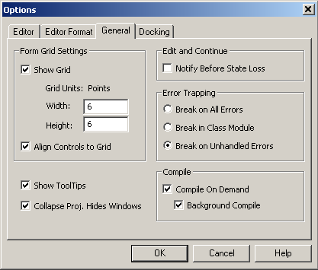
Advanced user FORM techniques
The Form Grid
The position and size of any control is constrained by the grid of dots that is displayed on the form. In other words, the corners of any control must fall on this grid, not in between two grids. This feature is valuable because it makes it easier for you to precisely align controls with each other and make controls the same size.
You can turn off the grid or change its size by selecting Tools → Options from the VBA Editor menu to display the Options dialog box, and then clicking the General tab
The Form Grid Settings part of the dialog box has the following settings:
Show Grid. If this option is checked, the grid is displayed. Note that the grid can be displayed without being active, and can also be active without being displayed.
Width, Height. This controls the spacing between grid points. The default is 6 points, or 1/12 inch.
Align Controls to Grid. If this option is checked, the position and size of controls are forced to align with the grid.

Slide 8
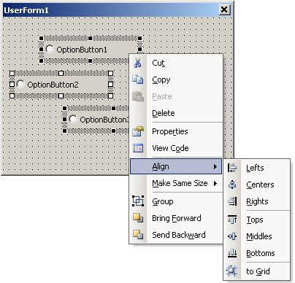
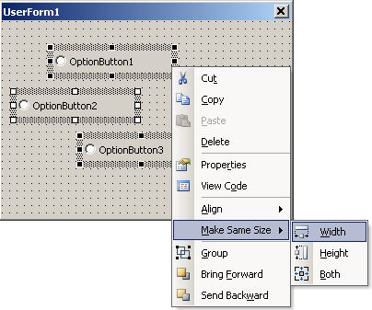
Advanced user FORM techniques
Control Placement and Alignment Tools
The form designed provides some handy tools that aid you in placing controls on a form and setting the sizes.
These tools let you place and size controls with a precision that is difficult to achieve manually.
To use most of these tools, you need to select multiple controls on a form as follows:
1. Click the first control to select it. This will serve as the guide control (explained later in this session).
2. Hold down the Shift key and then click the second control.
3. Repeat step 2 until all the desired controls are selected.
When you select multiple controls, the first control selected displays white handles while the other selected controls display black handles.
The white handles mark the guide control—the one used as the reference for the formatting commands.
Multiple selected controls can be moved as a group by dragging and can also be deleted as a group by pressing Delete.
More useful, however, are the commands found on the Format menu.

Slide 9
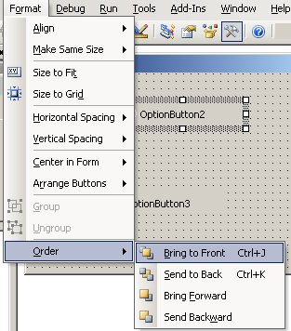
Advanced user FORM techniques
Overlapping controls and Z-Order
The layering of overlapping controls is determined by the z-order
The control that is on top, hiding all or part of other controls, is said to be at the top of the z-order
Likewise, the control that is under all other overlapping controls is at the bottom of the z-order
You can control the z-order at design time and in code
To change the z-order position of a control, select the control and then select Format➪ Order. There are four commands available on the submenu:
Bring to Front puts the control at the top of the z-order.
Send to Back puts the control at the back of the z-order.
Bring Forward moves the control up one position in the z-order.
Send Backward moves the control back one position in the z-order.
In code, you are limited to moving a control to the top or the back of the z-order using the ZOrder method. The syntax is
ControlName.ZOrder(position)

Slide 10
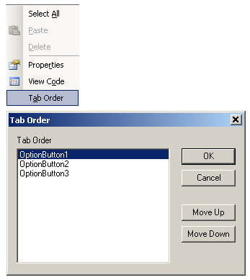
Advanced user FORM techniques
Focus and the TAB order
When a form is displayed during program execution, one control has the focus. This is indicated in various ways for different controls, the most common being the display of a dotted outline on or around the control.
The user can also move the focus by pressing Tab or Shift+Tab. The order in which the focus moves between controls is called the tab order
Tab moving forward in the order
Shift+Tab moving backwards
There are two control properties that relate to the tab order:
TabStop. If True, the control can receive the focus by tabbing. If False, the control can receive the focus only by clicking with the mouse. The default is True for all controls.
TabIndex. A numeric value specifying the position of the control within the tab order. The first control has TabIndex equal to zero.
There are three ways to change the tab order
You can manually edit the TabIndex property of all the controls on the form
You can also use the View➪Tab Order command, which displays the Tab Order dialog box
The last way to change the tab order is in code, by calling the UserForm object’s SetDefaultTabOrder method.

Slide 11
A User Form Example
Session Topics
Planning the sample project
Creating the workbook
Designing the form
Writing the code
Validating data
Testing the Project

Slide 12
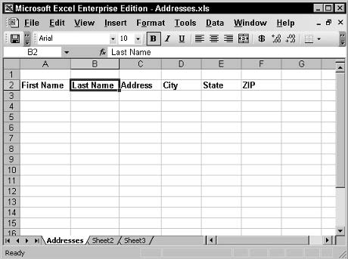
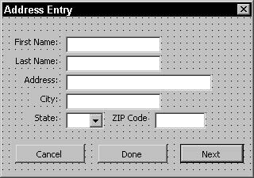
A User Form Example
Planning the project
Reasons why we need a Form.
User fatigue. Staring at a grid of worksheet rows and columns for extended periods can induce fatigue and increase the chance of errors. A nicely designed user form is much easier on the eyes.
Greater accuracy. You can write code to ensure that each item of data is placed in the proper location in the worksheet. Manual entry is much more prone to mistakes.
Data validation. Code in a user form can validate the data that was entered and perform checks, such as verifying that a zip code, for example, contains five digits and nothing more (or, in the case of the newer codes, nine digits and a dash). It’s much easier to catch bad data before it is entered than to deal with it later.
We will prepare a user form as shown in the figure B, and fill up the dataset as shown in the figure A
Figure A: Spreadsheet
Figure B: UserForm

Slide 13
A User Form Example
Creating the workbook
The first task to complete is creating the Addresses workbook. Follow these steps:
1. Start Excel to open a new, blank workbook.
2. Rename Sheet1 to Addresses by double-clicking the name tab on the worksheet and then entering the new name.
3. Enter the data column headings as shown in Figure. You can format these any way you want, but be sure they are in cells A2 through F2.
4. Save the workbook as Addresses.
At this point the workbook template is complete, and you can proceed with designing the user form.
Figure A: Spreadsheet

Slide 14
A User Form Example
Designing the Form
To create the new, blank user form and set its properties:
1. Press Alt+F11 to open the VBA Editor.
2. In the Project window, click the entry labeled VBAProject (Addresses).
3. Select Insert➪UserForm to add a new user form to the project.
4. Use the Properties window to change the form’s Name property to frmAddresses and its Caption property to Address Entry.
The Form Design
1. Add a TextBox control to the form, and change its Name property to txtFirstName.
2. Add a Label control next to the TextBox, and change its Caption property to First Name:.
3. Add four more TextBox controls, changing the Name properties to txtLastName, txtAddress, txtCity, and txtZip.
4. Put a Label control next to each of the new TextBox controls, and set the Caption properties to Last Name:, Address:, City:, and Zip Code:.
5. Add a ComboBox control to the form and change its Name property to cmbStates. Change its Style property to fmStyleDropDownList.
Figure B: UserForm
6. Put a Label control next to the ComboBox with the Caption property set to State:.
7. Add a CommandButton control. Change its Name property to cmdDone and its Caption property to Done.
8. Add another CommandButton control. Change its Name property to cmdNext, its Caption property to Next, and its Default property to True.
9. Add a third CommandButton control. Change its Name property to cmdCancel, its Caption property to Cancel, and its Cancel property to True.

Slide 15
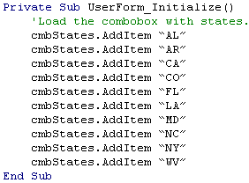
A User Form Example
Writing the Initialization code
The initialization code for this form needs to do only one thing: load the ComboBox control with abbreviations for all the states. For the sake of brevity, the code in this example loads only some states into the control; a real application would, of course, need to have all states in the ComboBox.
To add this code:
1. Click the View Code button in the Project window to open the code-editing window for the user form.
2. From the list at the top left of the window, select UserForm.
3. From the list at the top right of the window, select Initialize.
4. Enter the code from Listing 22-1 into this event procedure.

Slide 16
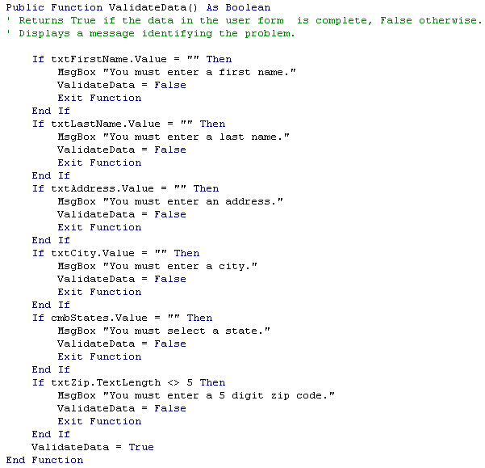
A User Form Example
Writing the data validation code
The verification code checks the data when the user clicks the Next or Done button. The specific items that need to be checked are:
The First Name, Last Name, Address, and City fields are not blank.
A state is selected.
The zip code field contains five characters. Because input to this field has been restricted to digits, this is all the verification that is required.
If the verification is successful, the data is entered in the worksheet, and the form is cleared and displayed again for another entry.
Both Done and Next button have the same function to validate the data entered. Hence we write the validation code in a separate Procedure\Function and not in the click event of the buttons.
Follow these steps to create the validation procedure:
1. Display the code-editing window for the user form.
2. Select Insert➪Procedure to open the Add Procedure dialog box.
3. Enter ValidateData as the procedure name; select Function under Type.
4. Click OK.

Slide 17
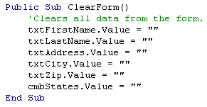
A User Form Example
Completing the project
To be complete, this project needs only the Click event procedures for the three CommandButton controls. To reiterate, this is what the command buttons should do:
The Next button validates the data. If validation succeeds, the data is entered in the worksheet, and the form is cleared for entry of the next address. If validation fails, the form retains its data so the user can correct it as needed.
The Done button performs the same tasks as the Next button with one exception: If validation succeeds, the form closes after the data is entered in the worksheet.
The Cancel button discards any data currently entered in the form and then closes the form.
You may have noticed that the Done and Next buttons share a task, which is entering the validated data in the worksheet. Whenever a task needs to be performed in more than one situation, a programmer recognizes this as an opportunity for putting the required code in a procedure. If you create a procedure that transfers the data from the form to the worksheet, this procedure can be called by both the Done and the Next button’s Click event procedure.
At the same time, the form needs code to clear all data from its controls. This is necessary when the Next button is clicked, of course, but also when the Cancel or Done button is clicked. Even though the form is hidden with the Hide method, it retains any data in its controls the next time it is displayed. For this reason, the controls need to be cleared. This is a simple matter of setting the Value property of each control to a blank string. This code is placed in a procedure named ClearForm. Add this procedure to the form now.

Slide 18
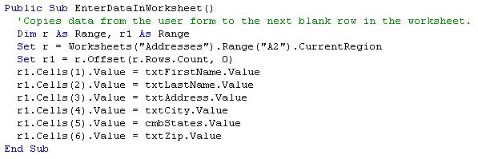
A User Form Example
Completing the project
Entering the data into the worksheet requires that the program locate the first empty data row. You know that the first column heading is in cell A2. This means that the first blank row could start in cell A3 or any cell below it. There are several ways you could identify the first empty row. The one used here is as follows:
1. Start with cell A2 as a reference point.
2. Use the CurrentRegion property to get a range containing the header row plus all existing data.
3. Use the Offset method to get a range offset by the number of rows in the original range. This new range is one row below the original range and contains the six cells in the first empty row.
4. Use the Cells property to access individual cells in this range to insert the data.

Slide 19
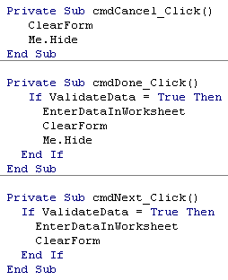
A User Form Example
Completing the project
Now that the procedure for data entry has been written, the project needs only the Click event procedures for the three CommandButton controls to be finished.
This code is shown below. Note that each of these three event procedures calls the ClearForm procedure that you created earlier. Enter this code in the user form, and the project is ready to try..

Slide 20
A User Form Example
Testing the Project
You can test the project by pressing F5 while the user form is open in the VBA Editor.
You can also write a macro that displays the form using the Show method.
Figure shows the program in action. When you try it out, you’ll see that this program and user form makes data entry much easier than it would be to enter the data directly in the workbook...

Slide 21
Working with Events
Session Topics
The categories of Excel events
Writing event handler code
Enabling and disabling events
Workbook, worksheet and application level events
How to use events not related to an object.

Slide 22
Working with Events
Event Categories
The events to which an Excel program can respond can be categorized in two ways. One method organizes events in terms of the object that receives the event, as follows:
Application events
Workbook events
Worksheet events
User form and control events
Nonobject events
Nonobject events is a special category that contains events not associated with a specific object.
The other way to categorize events is by the event itself, such as what happens to trigger the event. This results in three categories of events:
Events that are always the result of user actions, such as clicking a control on a user form or pressing a key
Events that can be caused either by user action or by VBA code, such as opening a workbook or activating a chart
Events that have no relation to user actions, such as the occurrence of a particular time of day

Slide 23
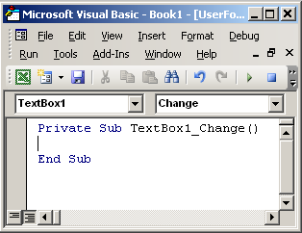
Working with Events
Event Handler Code
An event handler is a special kind of VBA procedure that is automatically executed when the related event occurs.
There’s a strict rule you must follow when naming these procedures; the name must be in the form of objectname_eventname. For example, the TextBox control has the Click event; for a TextBox whose name is txtAddress, the event handler procedure must be named txtAddress_Click
In most situations, the VBA Editor creates the outline (the first and last lines) of the event procedure for you.
When a code-editing window is open, there are two drop-down lists at the top of the window (see Figure 23-1).
The object list, at the top left, shows those objects for which event-handing code can be placed in the current window.
The event list at the top right lists the events for the object selected in the first list.
When you select an event, the Editor automatically enters the outline of the procedure in the window. You can enter event procedures manually, but this auto-entry feature saves time and reduces errors.
The Object List
The Event List

Slide 24
Working with Events
Event Sequences
When working with events, you need to understand that some actions result in more than one event being triggered in Excel. In these situations, the multiple events occur in a specific order. In some situations you need to be aware of this order when deciding which event procedure to use for your code.
Here’s an example: When a new worksheet is added to a workbook, the following three application-level events are triggered in this order:
WorkbookNewSheet occurs when you add a new worksheet.
SheetDeactivate occurs when the previously active worksheet is deactivated.
SheetActivate occurs when the new worksheet is activated.
A similar situation exists when the user clicks a control on a user form: the MouseDown, MouseUp, and Click events occur in that order.
Using the Debug.Print statement in event procedures, you can determine which events occur and in what order.

Slide 25
Working with Events
Workbook Events
Event | Occurs when
Activate | A workbook is activated
BeforeClose | A workbook is about to be closed
BeforePrint | All or part of the workbook is about to be printed
BeforeSave | A workbook is about to be saved
Deactivate | A workbook is deactivated
NewSheet | A new workbook is created
Open | A workbook is opened
SheetActivate | Any worksheet is activated
SheetChange | Any worksheet is changed by the user or code
SheetDeactivate | Any worksheet is deactivated
SheetSelectionChange | The selection on any worksheet is changed
To work with workbook-level events, open the ThisWorkbook module for the project.
Select Workbook in the object list; the event list contains all of these events plus some not covered here.

Slide 26

Working with Events
The Open Event
The Open event is perhaps the most widely used of the workbook-level events. Triggered when a workbook is opened, it can be used for a variety of tasks that include:
Opening other required workbooks
Activating a specific worksheet
Defining custom toolbars
Displaying welcome messages, reminders, or program instructions
For Example, the following codes gives a message “Thank GOD its Friday” when the workbook is opened on a Friday.

Slide 27
Working with Events
Worksheet Events
Event | Occurs when
Activate | The worksheet is activated
Calculate | The worksheet is recalculated
Change | Data in the worksheet is changed
Deactivate | The worksheet is deactivated
SelectionChange | The selection in the worksheet is changed
The event procedures for a worksheet-level event must be placed in the module for that specific worksheet.
To enter the outline of the event procedure, select Worksheet from the object list at the top left of the code-editing window and then select the specific event from the events list.

Slide 28
Working with Events
Application Events
Event | Occurs when
NewWorkbook | A new workbook is created
SheetActivate | Any worksheet is activated
SheetChange | Any worksheet is modified (by the user or code)
SheetDeactivate | Any worksheet is deactivated
WorkbookActivate | Any workbook is activated
WorkbookBeforeClose | Before any workbook is closed
WorkbookDeactivate | Any workbook is deactivated
WorkbookNewSheet | A new worksheet is added to any workbook
Application-level events are not restricted to a single workbook or worksheet, but respond to events in any workbook or worksheet.
Whether your program uses the more global event at the application level or the more local event at the workbook or worksheet level depends entirely on the needs of the program and the task the event procedure is to carry out.

Slide 29
Security Considerations
Session Topics
Protecting entire workbooks
Preventing changes to worksheet ranges
Preventing users from viewing and modifying VBA code
Using macro security to protect against malicious macro code

Slide 30
Security Considerations
Workbook Protection
You can protect an entire workbook in two ways.
One by following these steps
1. Select File -- Save As.
2. In the Save As dialog box, open the Tools menu (at the top right) and select General Options. Excel displays the Save Options dialog box, as shown in Figure.
3. Enter a password in the Password to open and/or the Password to modify text boxes, and click OK.
4. When requested, re-enter the password(s) to verify.
5. Back in the Save As dialog box, enter a file name and then click Save.
And Secondly by using VBA
the SaveAs method. The Password argument specifies the password required to open the file, and the WriteResPassword argument specifies the modify/save password.

Slide 31
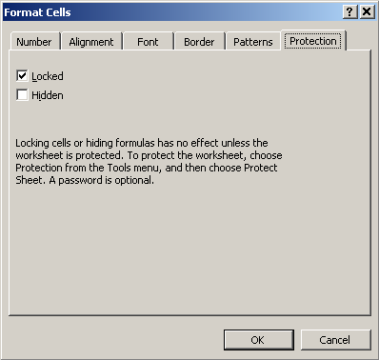
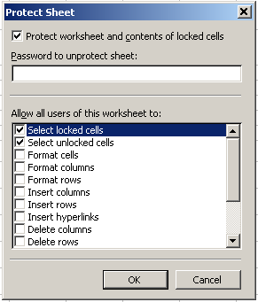

Security Considerations
Worksheet Protection
Worksheet protection is off by default; therefore, to allow users to enter data only in selected worksheet cells, you must follow these steps:
1. Select the cell(s) that the user will be permitted to edit.
2. Select Format➪Cells to display the Format Cells dialog box, and display the Protection tab as shown in the figure.
3. Turn off the Locked option; then click OK.
4. Repeat steps 1 through 3 to unlock addition cells, if needed.
5. Select Tools – Protection -- Protect Sheet to display the Protect Sheet dialog box as shown in the figure.
6. To ensure that users are not able to remove protection, enter a password in the designated field. If this is not a concern, leave this field blank.
7. Click OK.
To remove protection from a worksheet, select Tools – Protection -- Unprotect sheet. You have to enter the password if one was assigned.
Protecting through a VBA code

Slide 32
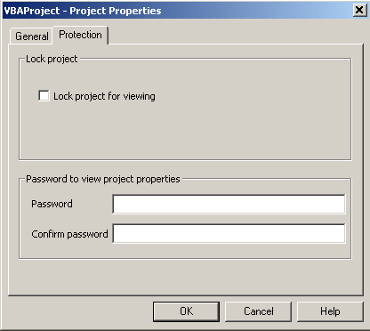
Security Considerations
Protecting VBA code
We can lock a VBA project and assign a password to it; then, users can run your programs, but they can’t view or modify their code
To protect a VBA project, follow these steps:
1. In the VBA Editor, make sure the correct project is active.
2. Select Tools -- Project Properties.
3. In the Project Properties dialog box, select the Protection tab.
4. Select the Lock Project for Viewing option; then enter and confirm the password.
5. Click OK.
When a project is protected, users are prompted for the password if they try to open the project in the VBA Editor.

Slide 33
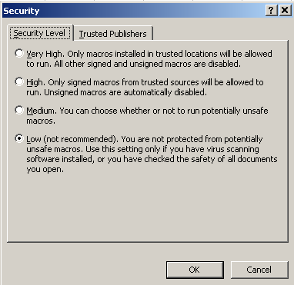
Security Considerations
Macro Security
Execution of macros is controlled by Excel’s Macro Security settings.
To set Excel’s macro security level, follow these steps:
1. In Excel, select Tools – Macro -- Security to display the Security dialog box.
2. Select the Security Level tab (see Figure 24-5).
3. Select the desired security level (see the following list) and then click OK.
The available security levels are
High. Only macros signed by trusted sources are run.
Medium. Macros from trusted sources are run. The user is prompted to run other macros (those signed by sources not on the trusted list or not signed at all).
Low. All macros are run without restriction.

Slide 34
Debugging
Session Topics
Understanding program bugs
Avoiding program bugs
Using VBA’s debugging tools

Slide 35
Debugging
What is a bug
A bug is an error in code that prevents a program from working properly. You can think of a bug as similar to an error, although these two terms have different meanings in programming circles.
An error (sometimes called runtime error) is a problem that prevents the program from running. If not handled properly, an error has the potential to stop a program dead in its tracks.
A bug does not prevent a program from running. Rather, it causes the program to produce incorrect results. For example, a data input program that inserts the data into the wrong part of a worksheet is considered a bug.
While VBA reports errors to you, there’s no such mechanism for bugs. The only way to find bugs is to test your program; then test it again.

Slide 36
Debugging
Avoiding Bugs
The most important step you can take to reduce bugs in your programs is to always use the Option Explicit statement. When this statement is in effect, each and every variable in your program must be explicitly declared.
If you try to use an undeclared variable, VBA displays an error message. This prevents misspelled variable names from slipping by.
Without Option Explicit, a misspelled variable name is merely considered to be a new variable, and the result is likely to be a bug.
If your program contains a lot of code, divide it into relatively small procedures. Large procedures are more prone to bugs and are more difficult to fix when a bug does occur.
Use global and public variables only when really necessary. While this type of variable may seem to simplify certain programming tasks, they are prone to problems.
Be sure to use a floating-point data type for numeric variables when required. Use of an integer type in certain situations can result in rounding errors and bugs.

Slide 37
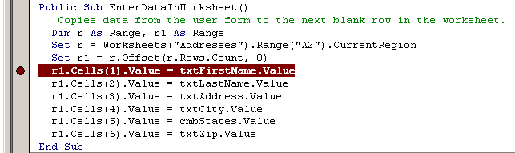
Debugging
Debugging Tools
Breakpoints
In the VBA Editor, you can set a breakpoint on any line of code. When execution reaches that line of code, VBA enters break mode, which allows you to perform various debugging tasks
To set a breakpoint, put the editing cursor on the line of code and then press F9.
You can use this same technique to remove a breakpoint, too.
A line with a breakpoint is displayed as light text on a dark background and a circle icon in the adjacent margin, as shown in Figure
You can set as many breakpoints in a program as you need.
Breakpoints are useful for tracing program execution.
When VBA is in break mode, you can perform other debugging actions, described in the following sections.
When VBA has stopped at a breakpoint, the line is highlighted in yellow.

Slide 38
Debugging
Debugging Tools
Breakpoints
When VBA is in break mode, you can perform other debugging actions, described in the following sections.

Slide 39
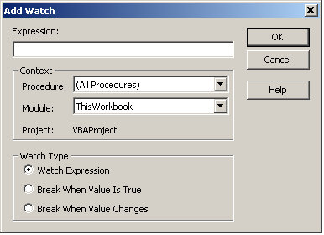
Debugging
Debugging Tools
Using Watches
A watch enables you to determine the value of a program variable during execution.
The simplest way to check a variable is in break mode. Simply rest the mouse cursor over the variable’s name in your code, and VBA pops up a small window with the current value. When this is not sufficient, VBA offers more sophisticated watch tools.
VBA can monitor the value of any variable or expression during program debugging.
A watch expression can be any VBA expression, such as a program variable, an object property, or a function call.
There are several ways you can use a watch expression:
You can monitor its value. Visual Basic displays the expression value in the Watches window (this window opens automatically when you define a watch expression). The displayed value is updated whenever the program enters break mode.
You can specify that the program enter break mode whenever the value of the expression changes.
You can specify that the program enter break mode whenever the value of the expression becomes True.
To set a watch expression, select Debug -- Add Watch to open the Add Watch dialog box as shown in Figure

Slide 40
Defining and Using Custom Classes
Session Topics
Fundamentals of VBA classes
Advantages of using classes
Creating class properties
Defining class methods
Class Events

Slide 41
Defining and using Custom Classes
Class Fundamentals
A class is a plan, or blueprint, for an object that performs a task needed by your program.
After the class is complete, you can use it like any other class or data type in VBA, creating as many instances (objects) from the class as you want.
Programmer-defined classes can have properties and methods as well as event procedures for class events.
They cannot, however, have a visual interface
VBA class definition resides in a class module and a module holds only a single class.
To add a new class to a VBA project, select Insert → Class Module from the VBA Editor menu
The class is assigned a default name such as Class1, Class2, and so on. Be sure to change this to something descriptive of the class because this is the name you use in code to create instances of the class.
To change a class’s name, change the Name property in the Properties window.
Advantages of Classes
Ease of use. After a class is defined, using it in a program is easy. Create an instance of the class and call its properties and methods—what could be easier?
Reusability. A properly designed and programmed class is a self-contained unit that performs a specific task. It’s a simple matter to use a class in as many VBA projects as needed, with no extra programming effort.
Fewer errors and bugs. A class is by its very nature isolated from the rest of the program except for the properties and methods that you specifically create. As such, it is less prone to program errors and bugs that can be caused by unintended interactions between different sections of code.
You must instantiate the class in your program that is, create an object based on the class before you can use it in your program. The syntax is the same as for any of the classes in the Excel object model:
Dim varname As New classname
Varname is any legal VBA variable name, and classname is the name of the class.

Slide 42
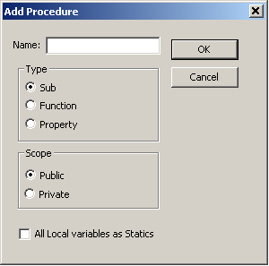

Defining and using Custom Classes
Class Properties
A property is an individual piece of information stored by the class
A property can be any of VBA’s built-in data types
Most class properties are read/write properties, meaning that a program can both set the property value as well as read it. For this kind of property, a class module needs three elements:
A class variable to store the property value. This variable must be declared at the module level (outside of any procedures) using the Private keyword.
A Property Get procedure that is called when a program retrieves the property value. A Property Get procedure is actually a function that returns a value (the property value).
A Property Let procedure that is called when a program sets the property value.
Creating Property Procedures
1. With the class module active, select Insert → Procedure from the VBA Editor menu to display the Add Procedure dialog box (see Figure).
2. In the Name field, enter the name of the property.
3. In the Type section, select the Property option.
4. Click OK.
Please note several things about these procedures:
The Get procedure has a return value. The data type of this value is by default Variant, as indicated by the As Variant clause. It is this return value that passes the property value to a program that requests it.
The Let procedure is passed an argument named vNewValue, which is also type Variant by default. When a program sets the property value, the new value is passed to the object in this argument.
Both procedures contain no code they still must be connected to the property.

Slide 43
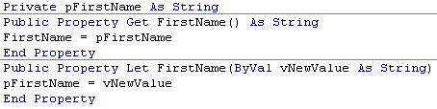
Defining and using Custom Classes
Property Variable
A class needs a place to store a property value. The property procedures do not provide this all they provide is a connection between the property and the program outside the class. In most cases, the property value is stored in a module-level variable. The syntax is as follows:
Private varname As datatype
This statement must be placed at the module level, outside of any property procedures or methods in the class. The elements of this declaration are:
The Private keyword limits the variable’s scope to the class module. In other words, the variable is not directly accessible to code outside the class.
Varname is any legal VBA variable name.
Datatype specifies the type of the property. It can be any of VBA’s data types or a user-defined type.
Connecting the Property to the Property Procedures
The final step in creating a class property is to connect the property variable to the property procedures. Here is what’s required:
1. Change the data type of the Let procedure’s argument to match the data type of the property variable. If the type is Variant, no change is needed.
2. Change the return type of the Get procedure to match the data type of the property variable. Again, if the type is Variant, no change is needed.
3. Add code to the Get procedure that returns the value of the property variable to the calling program.
4. Add code to the Let procedure that stores the value passed in the procedure argument in the property variable.

Slide 44
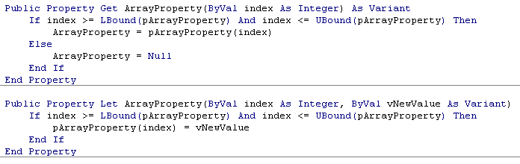
Defining and using Custom Classes
Array Properties
In some situations you may need to implement a property that is an array
For example, if you need a property that holds more than one value, you can use this technique.
This can be accomplished by adding an extra argument to both the Get and the Let procedures. This argument serves as the index into the array. The property variable itself must of course be an array.
For example: Private pArrayProperty(100) As Variant
The Get and Let procedures would then look similar to the following. Note that both the Get and the Let procedures check the value of the index variable to ensure that it is within the legal range for the property array.
To use an array property, you must specify the array index when setting or reading the property:
X = Obj.ArrayProperty(5)
Obj.Property(10) = “Smith”

Slide 45
Defining and using Custom Classes
Other Properties
Read only Properties
A property can be made read-only by deleting its Get procedure.
A program can read such a property but cannot set its value.
Accessing properties in a code
Properties of programmer-defined classes are accessed similar to any other properties, using the ObjectName.PropertyName syntax.
Suppose you create an instance of the Person class as follows:
Dim Somebody As New Person
You could then set its properties as follows:
Somebody.FirstName = “Henry”
Somebody.LastName = “Brinkler”
And likewise, read its properties as shown here:
str = Somebody.FirstName

Slide 46
Defining and using Custom Classes
Good to know about classes
Property Validation
A property procedure can be used to validate property data.
Specifically, the Let procedure can include code that verifies the property value passed to the object meets the requirements of the program.
For example, a Telephone Number property could include validation to ensure that a valid number in the format nnn-nnn-nnnn was passed to the property.
If the property value fails validation, the code in the Let procedure can take appropriate action, such as displaying a warning message to the user.
Class Events
A VBA class module has two events associated with it. They are
Initialize. Triggered when the class is instantiated.
Terminate. Triggered just before the object is destroyed.
The Initialize event procedure can be used to initialize the value of variables in the object or perform other actions that are required.
The Terminate event procedure can be used to perform any required cleanup, including tasks such as saving object data.
Reusing a Class
After you have defined a class in one VBA project, you can use it in any other VBA project. Here are the steps required:
1. In the VBA Editor, activate the class module.
2. Select File → Export File to display the Export File dialog box.
3. Select a path for the exported file. The default filename is the class name with the .CLS extension. You can change the name, but not the extension.
4. Click Save.
5. Open the second project; if it is already open, activate it.
6. Select File → Import File to display the Import File dialog box.
7. Select the file you exported and then click Open.

Slide 47
Q & A
Thank You!!

